Slide 1
CS1980 – Capstone
PSC - VVFS
By:
James D. McMillian
2013 December 8

Slide 2
Project Goals
Reduce data duplication through dynamic manipulation of datasets
Understand the Data
Previous Work : ScriptFS
  Identify shortcomings
  Conceive of a workaround
Develop a feasible solution to the VVFS
  Identify requirements
  Template a framework
  Implement a proof of concept prototype

Slide 3

The Data
Petabyte Scale Full Data Sets
Arranged in stacks, our working stack
  10400 sections
Sections
  4 x 4 grid of (16) tiles
  ~30nm thickness each
Tiles
  25600 x 25600 pixels at 4nm per pixel
  8bit B/W intensity levels from electron microscopy
${25600}^{2} × 4^{2} ×10400 = \sim 109.05 TB$

Slide 4
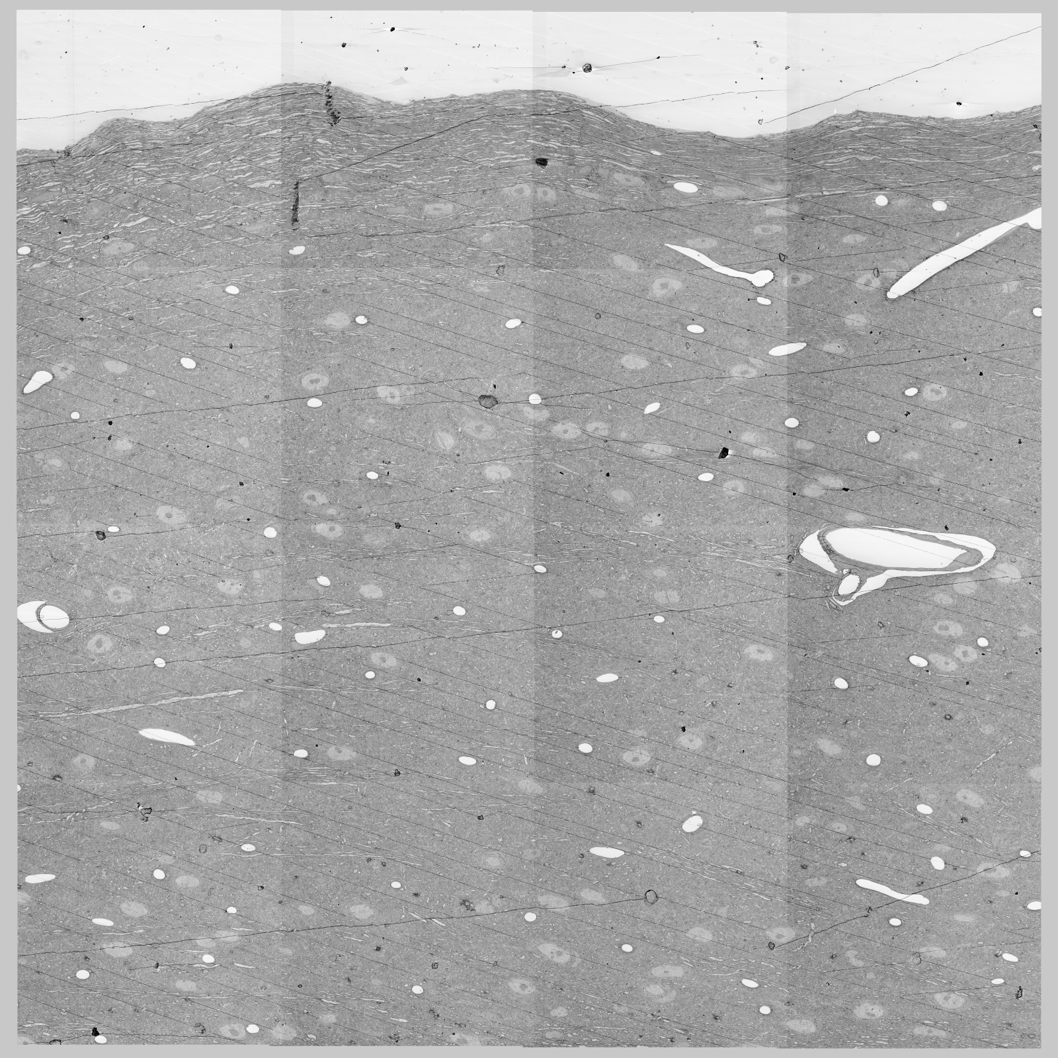
Section near middle of stack
Section Issues between images:
Tonal Variations
Artifacts
Wrinkles
~64:1 composited image S8eoS2S4_100.jpg

Slide 5
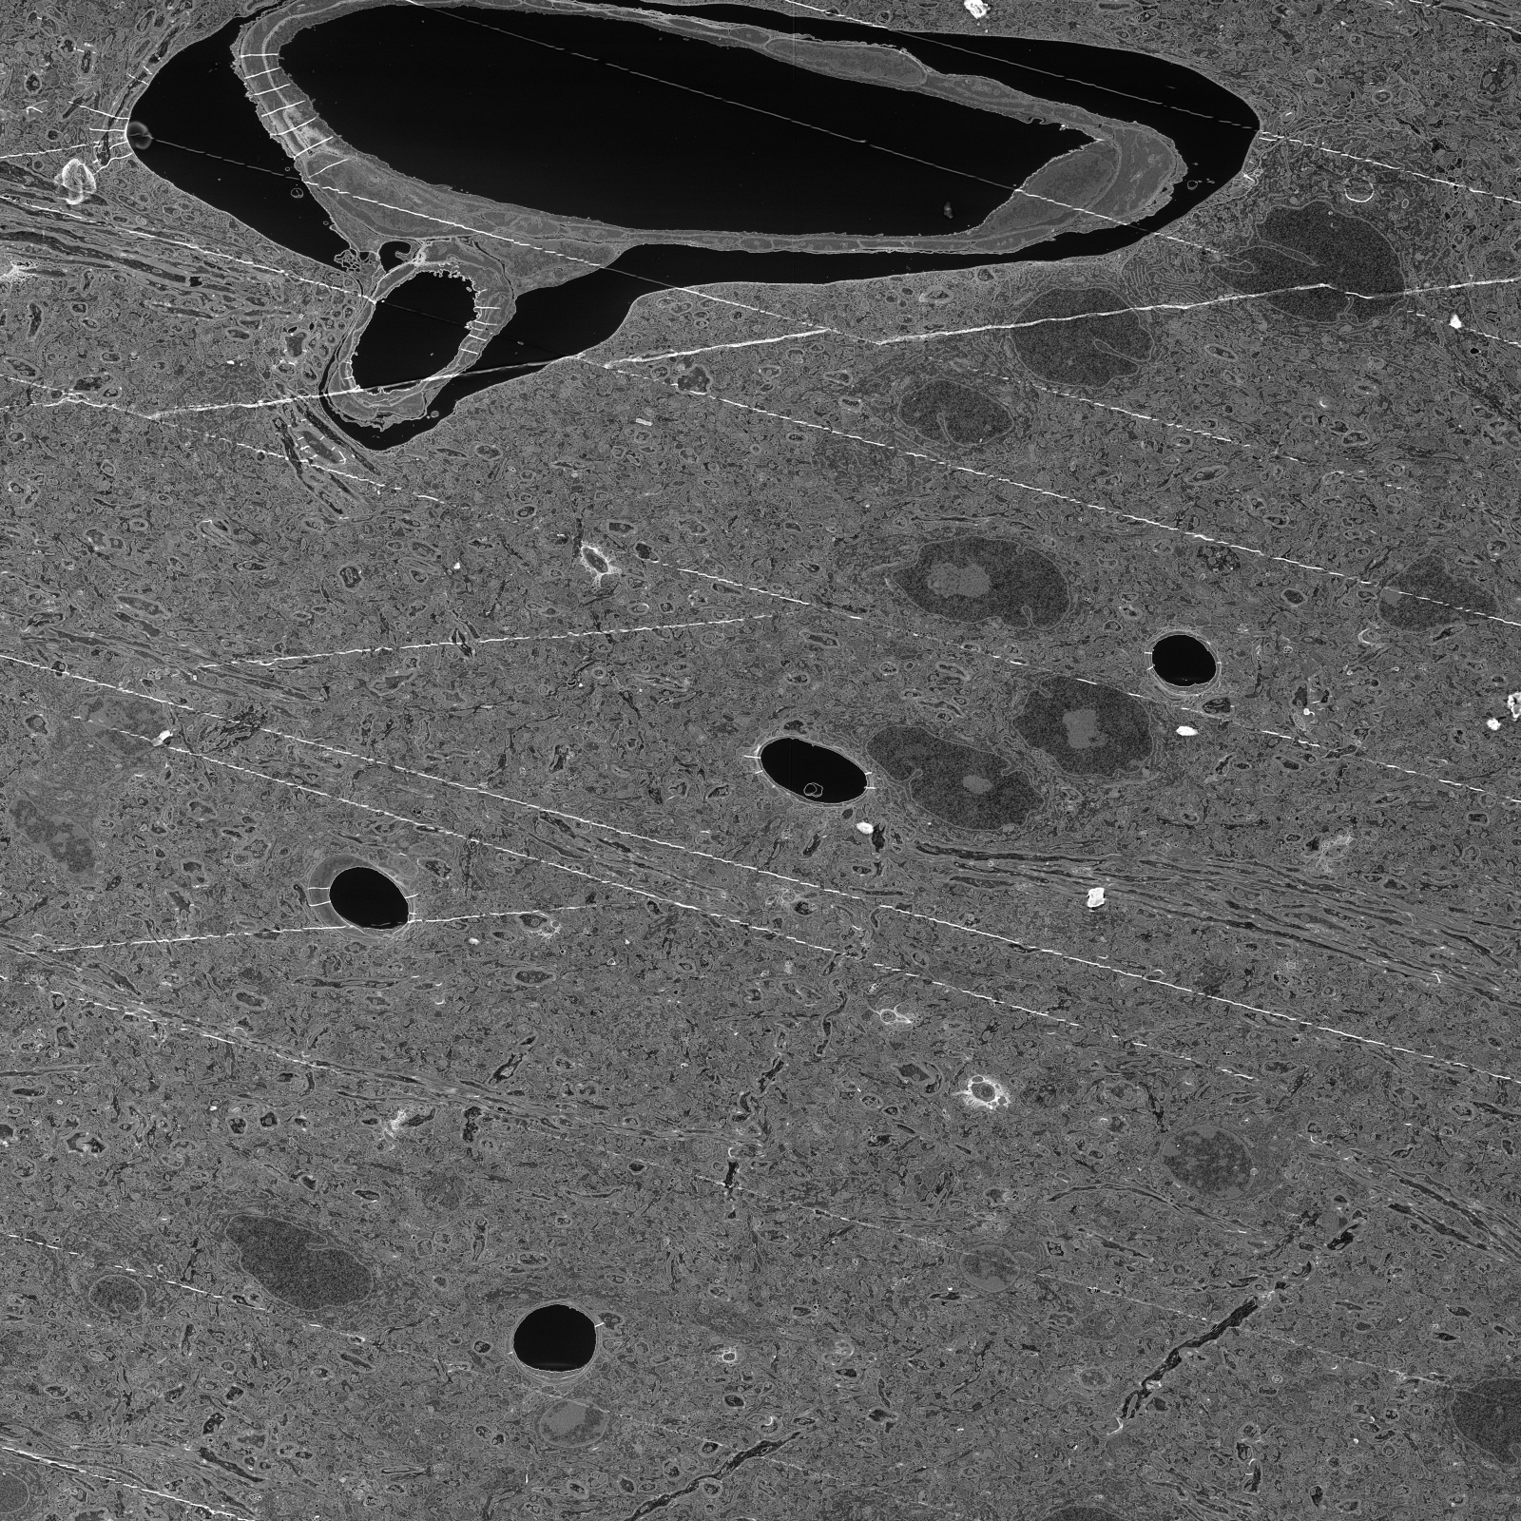
~8:1 S4S4r3-c4.jpg
25600 x 25600
~625 MB
~8:1 reduced image / S4S4r3-c4.jpg

Slide 6
Requirements
Languages
  C/C++
Operating System
  Linux/[Ubuntu 12.04]
Libraries
  Base libraries only
  FUSE

Slide 7
Framework
Modular
  Modules)
    Affine transforms
    Image output formats
    Image
  User Space Environment
  Thread Safe / MPU support

Slide 8
Prototype
Arguments
  Mount point of VVFS
  Location of Source Files
  Location of transform functions
Example:
  ./vvfs mount=/home/username/vvfs/mount data=/home/username/vvfs/data functions=/home/username/vvfs/extensions

Slide 9
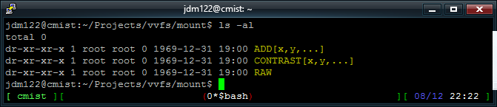
Root of VVFS
ls –al

Slide 10
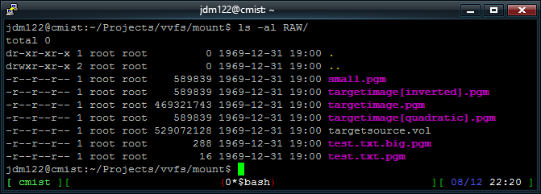
A virtual folder
ls –al RAW/

Slide 11
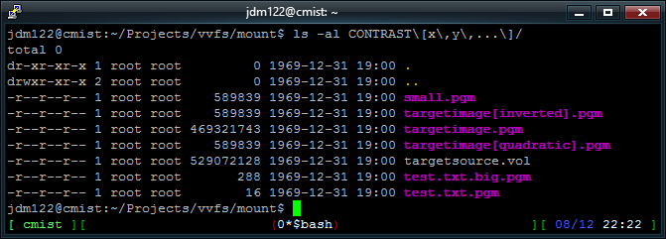
A different virtual folder
ls -al CONTRAST[x,y,...]/

Slide 12
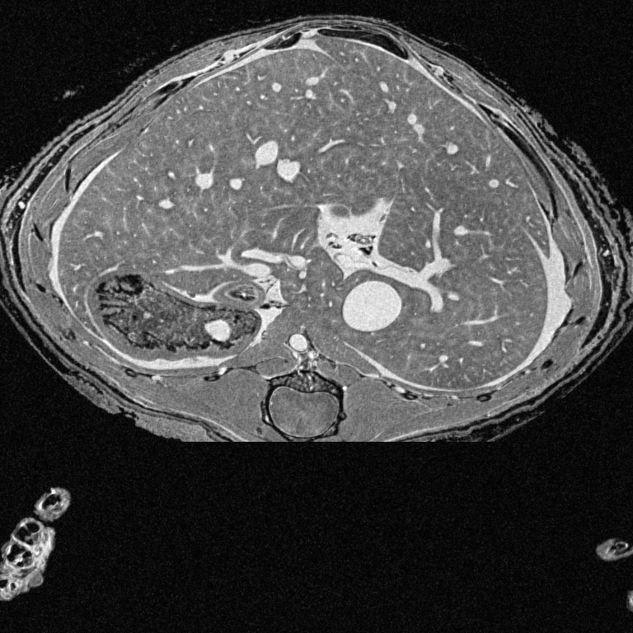
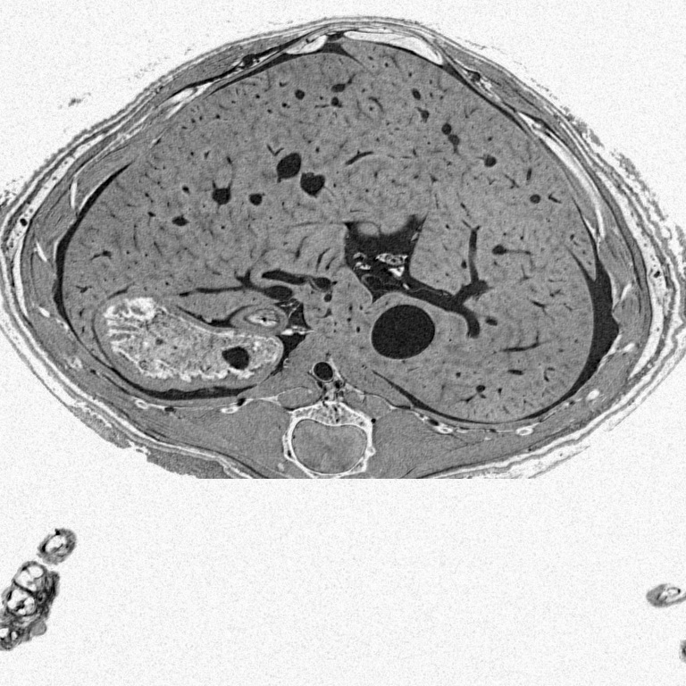
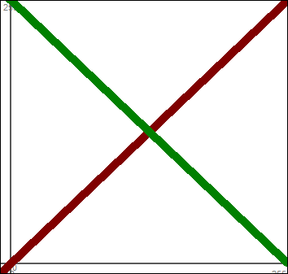
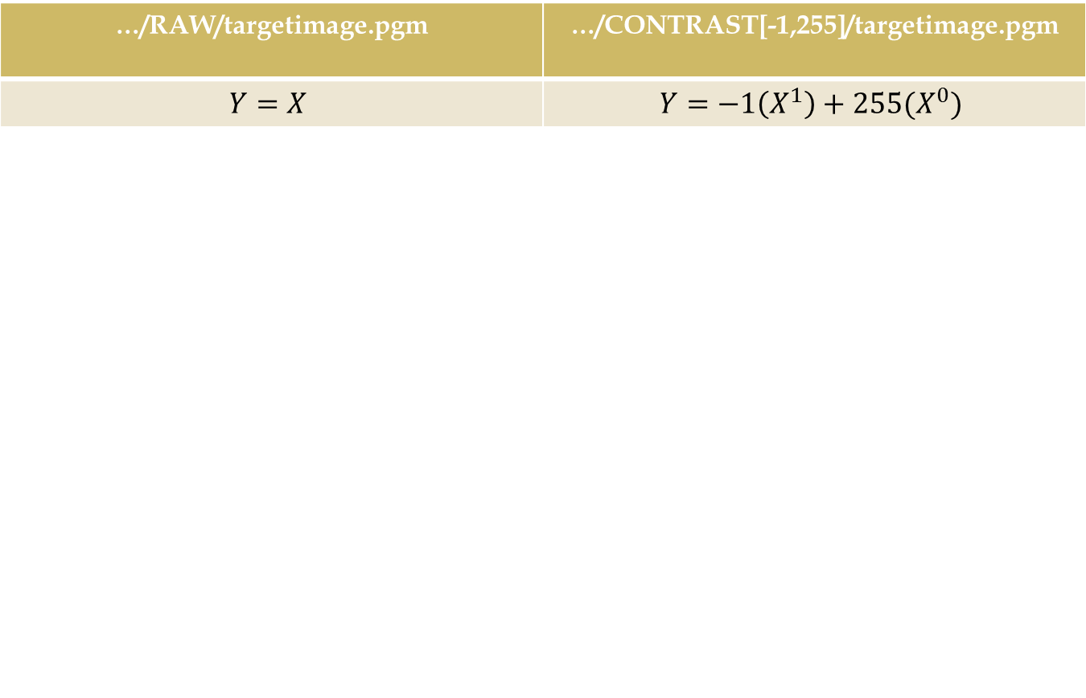
Transformed Images
…/RAW/targetimage.pgm | …/CONTRAST[-1,255]/targetimage.pgm
$$Y=X$$ | $$Y=−1\left(X^{1}\right)+255(X^{0})$$

Slide 13
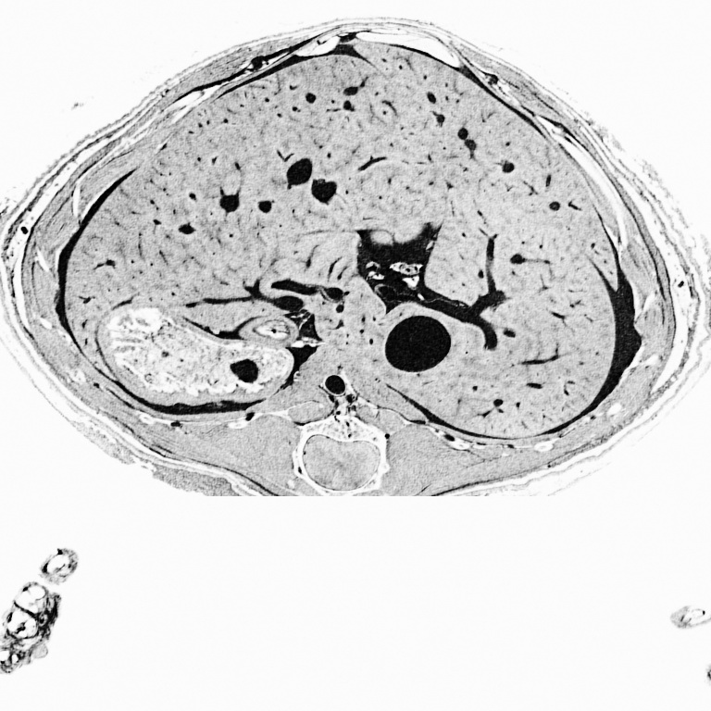
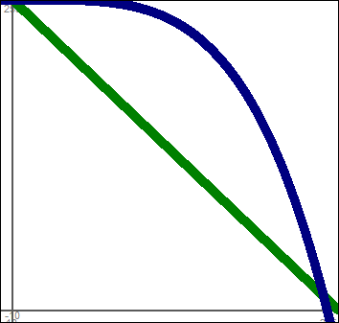
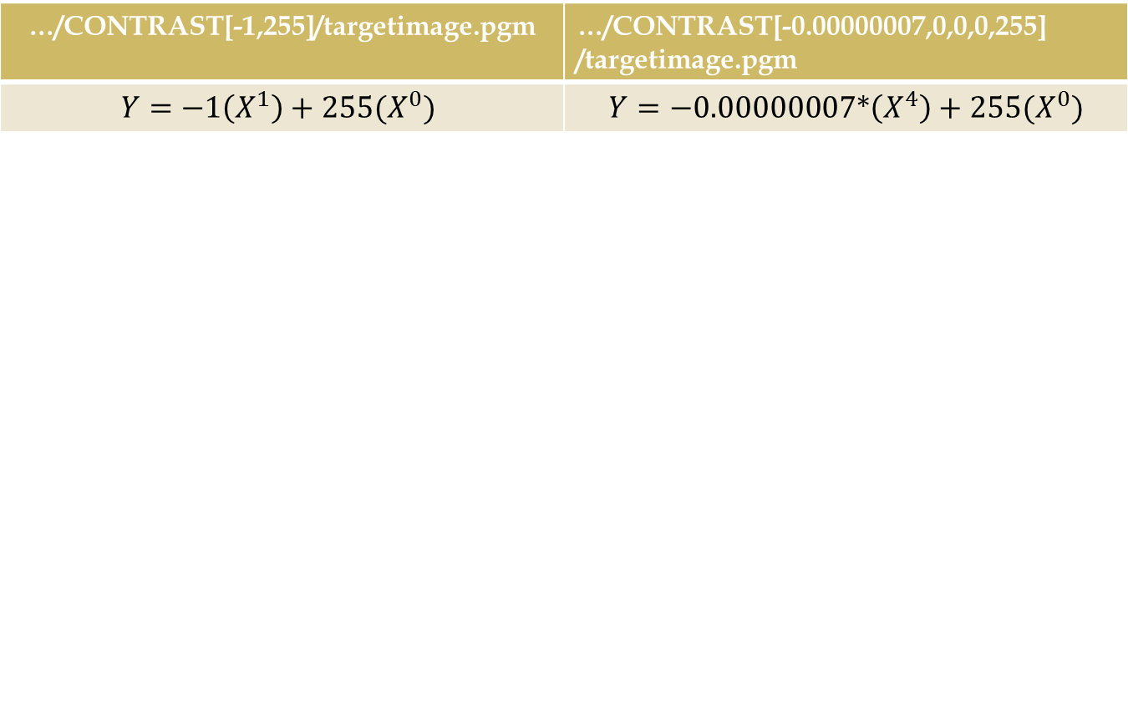
Transformed Images
…/CONTRAST[-1,255]/targetimage.pgm | …/CONTRAST[-0.00000007,0,0,0,255] /targetimage.pgm
$$Y=−1\left(X^{1}\right)+255(X^{0})$$ | $$Y=−0.00000007∗\left(X^{4}\right)+255(X^{0})$$

Slide 14
Conclusion
SUCCESS… , well… At least partially…
  Proof of concept works… What’s Next?
    More Transforms??
      Translate/Rotate/Scale/Skew????
      Windows Selections????
      3d Volume generator????
    Flesh out file system more?
      More file information????
      Pre-calculate file sizes????
So what now?

Slide 15
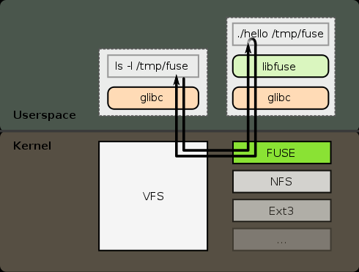
Future Work
Stress and Speed Testing FUSE

Slide 16
If its acceptable…
Assumptions : FUSE is an acceptable solution
  Execution Speed
  Multiple network access
  Multi-User Access
  Thread safe environment
Then?

Slide 17
If its acceptable…
Assumptions : FUSE is an acceptable solution
  Execution Speed
  Multiple network access
  Multi-User Access
  Thread safe environment
Then?
  All current code will likely die.
  As the first real initial attempt system is designed.

Slide 18
…
Questions???

